Slide 1


Dimensionality Reduction – PCA and LDA
Dr. Babji Srinivasan
Associate Professor
Department of Applied Mechanics
IIT Madras

Slide 2
DIMENSIONALITY REDUCTION
2

Slide 3

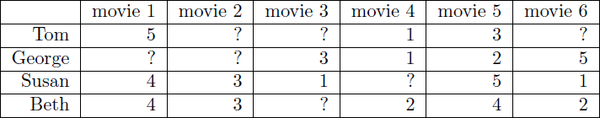
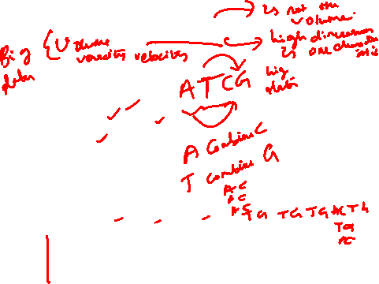
Big & High-­‐Dimensional Data
High-­‐Dimensions = Lot of Features
Document classiﬁcation Features per document = thousands of words/unigrams
millions of bigrams, contextual information
Surveys -­‐ Netﬂix
480189 users x 17770 movies

Slide 4
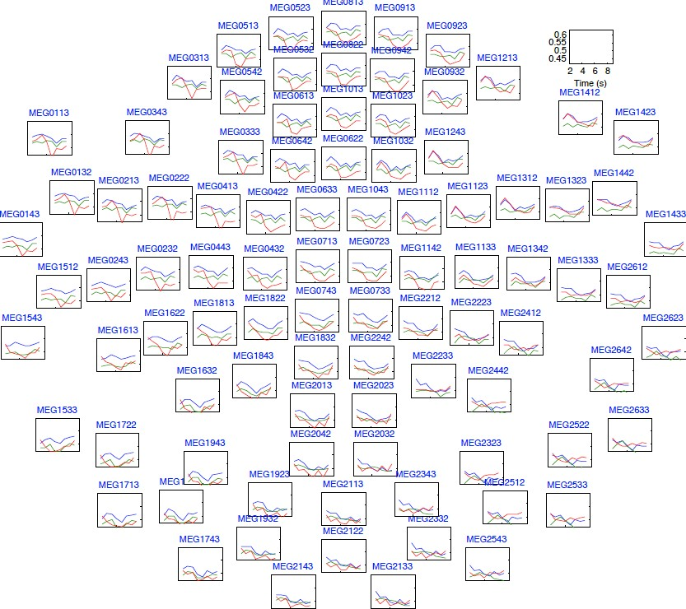
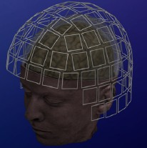



Big & High-­‐Dimensional Data
High-­‐Dimensions = Lot of Features
MEG Brain Imaging
120 locations x 500 time points
x 20 objects
Or any high-­‐dimensional image data

Slide 5
Big & High-­‐Dimensional Data.
Useful to learn lower dimensional representations of the data.

Slide 6

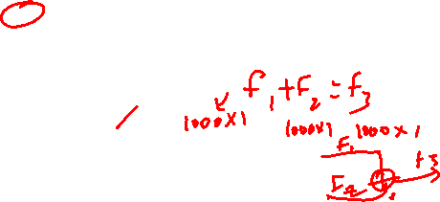
Learning Representations
PCA, Kernel PCA, ICA, Discriminant Analysis: Powerful unsupervised learning techniques for extracting hidden (potentially lower dimensional) structure from high dimensional datasets.
Useful for:
Visualization
More eﬃcient use of resources (e.g., time, memory, communication)
Statistical: fewer dimensions → better generalization
Noise removal (improving data quality)
Further processing by machine learning algorithms

Slide 7
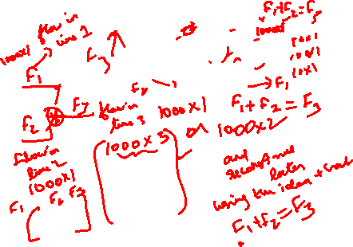

Slide 8
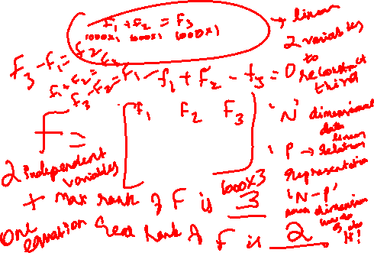

Slide 9
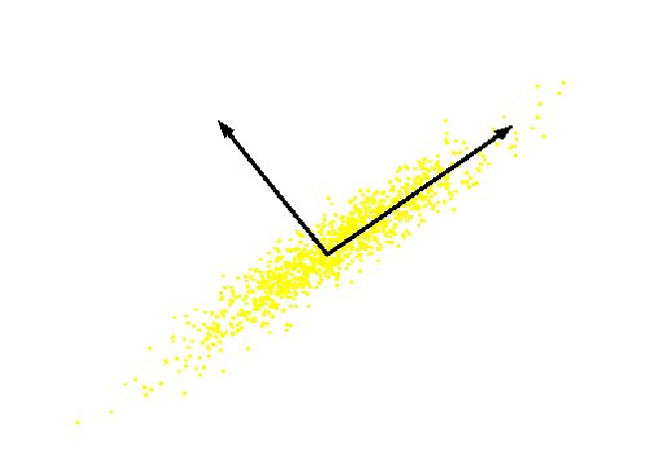
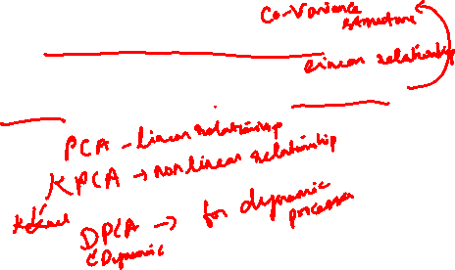

Principal Component Analysis (PCA)
What is PCA: Unsupervised technique for extracting variance structure from high dimensional datasets.
PCA is an orthogonal projection or transformation of the data into a (possibly lower dimensional) subspace so that the variance of the projected data is maximized.
Slide from Nina Balcan

Slide 10
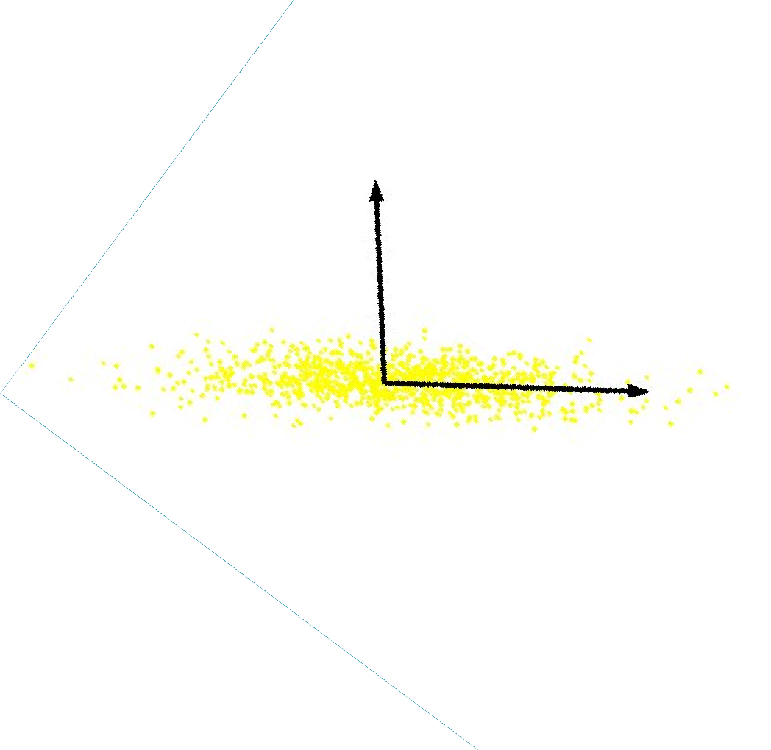


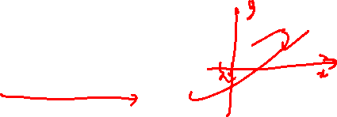
Principal Component Analysis (PCA)
Intrinsically lower dimensional than the dimension of the ambient space.
If we rotate data, again only
one coordinate is more important.
Only one relevant feature
Both features are relevant
Question: Can we transform the features so that we only need to preserve one latent feature?
Slide from Nina Balcan

Slide 11
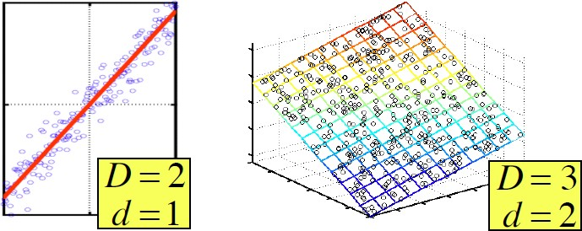



Principal Component Analysis (PCA)
In case where data lies on or near a low d-­‐dimensional linear subspace, axes of this subspace are an eﬀective representation of the data.
Identifying the axes is known as Principal Components Analysis, and can be obtained by using classic matrix computation tools (Eigen or Singular Value Decomposition).
Slide from Nina Balcan

Slide 12
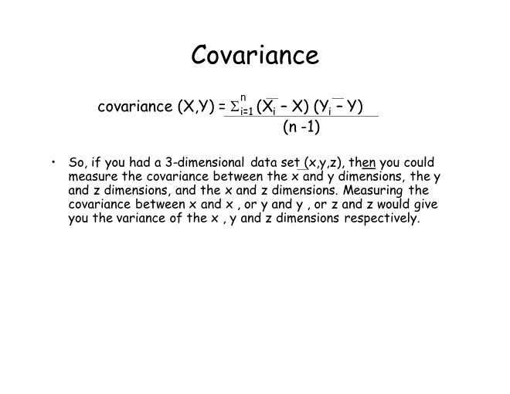

Covariance
Variance and Covariance are a measure of the “spread” of a set of points around their center of mass (mean)
Variance – measure of the deviation from the mean for points in one dimension e.g. heights
Covariance as a measure of how much each of the dimensions vary from the mean with respect to each other.
Covariance is measured between 2 dimensions to see if there is a relationship between the 2 dimensions e.g. number of hours studied & marks obtained.
The covariance between one dimension and itself is the variance

Slide 13
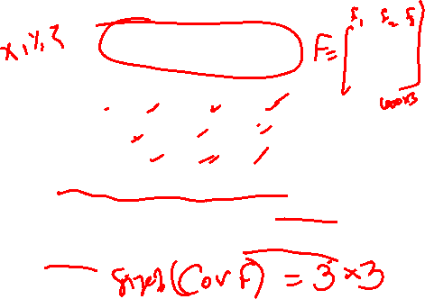

Covariance Matrix
Representing Covariance between dimensions as a matrix e.g. for 3 dimensions:
cov(x,x) cov(x,y) cov(x,z)
C = cov(y,x) cov(y,y) cov(y,z)
cov(z,x) cov(z,y) cov(z,z)
Variances
Diagonal is the variances of x, y and z
cov(x,y) = cov(y,x) hence matrix is symmetrical about the diagonal
N-dimensional data will result in NxN covariance matrix

Slide 14
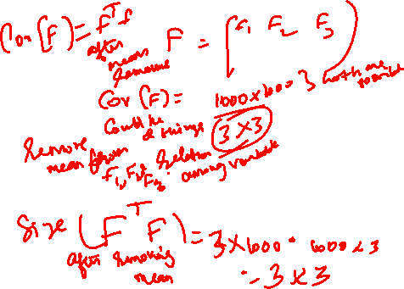
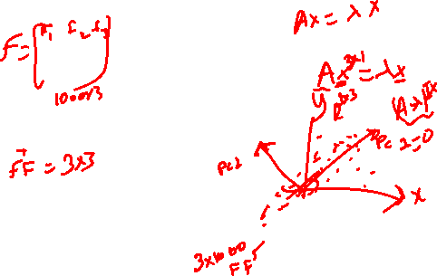

Slide 15
Covariance
What is the interpretation of covariance calculations?
e.g.: 2 dimensional data set
x: number of hours studied for a subject y: marks obtained in that subject covariance value is say: 104.53
what does this value mean?

Slide 16
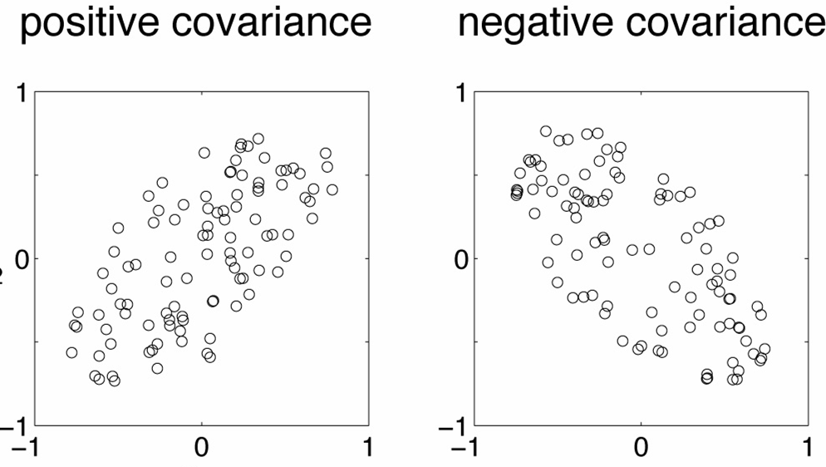
Covariance examples
Y
X

Slide 17
Covariance
Exact value is not as important as it’s sign.
A positive value of covariance indicates both
dimensions increase or decrease together e.g. as the
number of hours studied increases, the marks in that subject increase.
A negative value indicates while one increases the
other decreases, or vice-versa e.g. active social life at PSU vs performance in CS dept.
If covariance is zero: the two dimensions are independent of each other e.g. heights of students vs the marks obtained in a subject

Slide 18
Covariance
Why bother with calculating covariance when we could just plot the 2 values to see their relationship?
Covariance calculations are used to find relationships between dimensions in high dimensional data sets (usually greater than 3) where visualization is difficult.

Slide 19
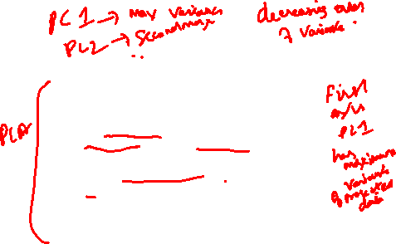
PCA
principal components analysis (PCA) is a technique that can be used to simplify a dataset
It is a linear transformation that chooses a new coordinate system for the data set such that
greatest variance by any projection of the data set comes to lie on the first axis (then called the first principal component),
the second greatest variance on the second axis, and so on.
PCA can be used for reducing dimensionality by eliminating the later principal components.

Slide 20
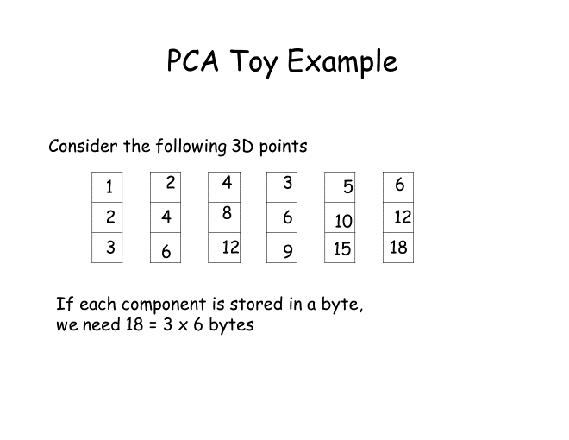
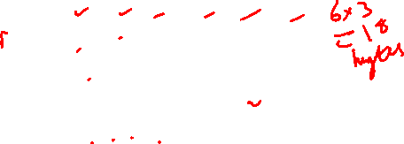

Slide 21
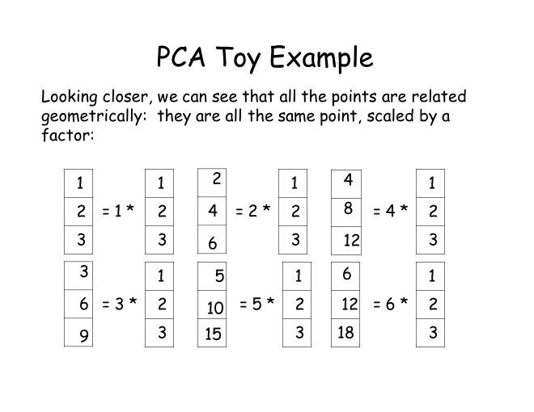


Slide 22
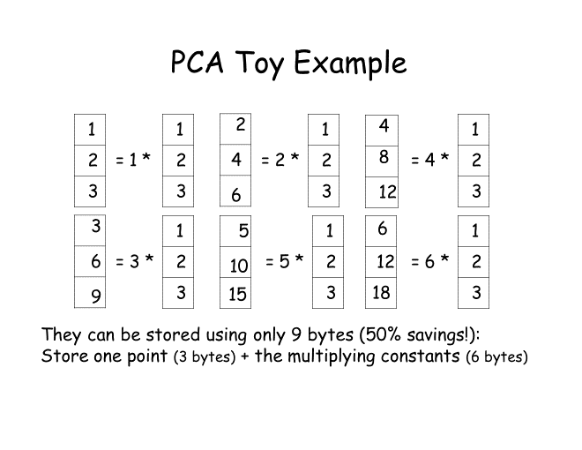
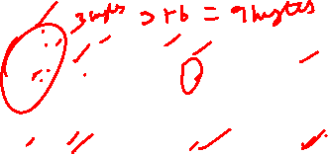

Slide 23



Geometrical Interpretation:
View each point in 3D space.
p3
p2
p1
But in this example, all the points happen to belong to a line: a 1D subspace of the original 3D space.

Slide 24
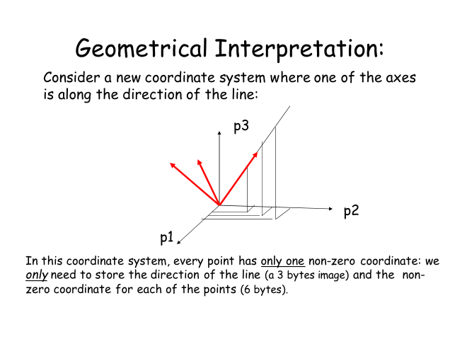


Slide 25
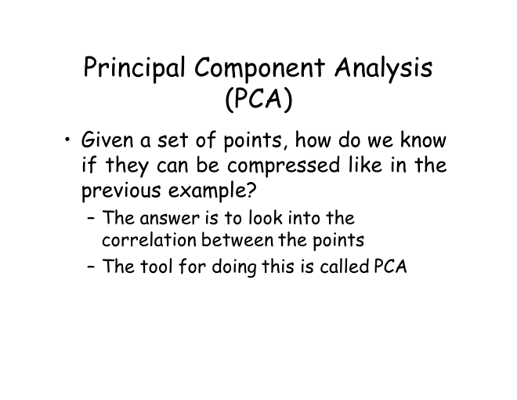


Slide 26
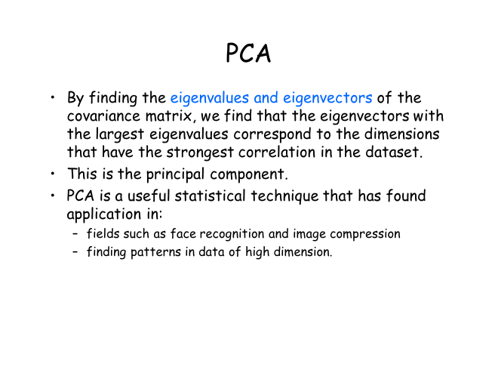

Slide 27
PCA algorithm II (sample covariance matrix)
Given data {x₁, …, x_{m}}, compute covariance matrix Σ
1
m
m
1
m
i
∑
x = _{m} ∑ x
Σ =
(x − x)(x − x)
T
where
i
i=1
i=1
PCA basis vectors = the eigenvectors of Σ
We get the eigvectors using an eigendecomposition.
Larger eigenvalue ⇒ more important eigenvectors

Slide 28
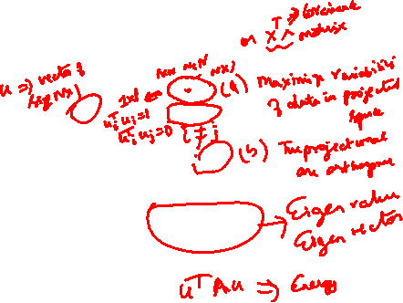
Why the Eigenvectors?
Maximise s.t
u^{T}XX^{T}u
u^{T}u = 1
Construct Lagrangian u^{T}XX^{T}u – λu^{T}u
Vector of partial derivatives set to zero
xx^{T}u – λu = (xx^{T} – λI) u = 0
As u ≠ 0 then u must be an eigenvector of XX^{T} with eigenvalue λ

Slide 29
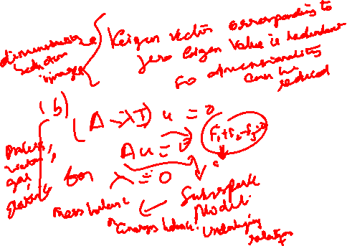

Slide 30
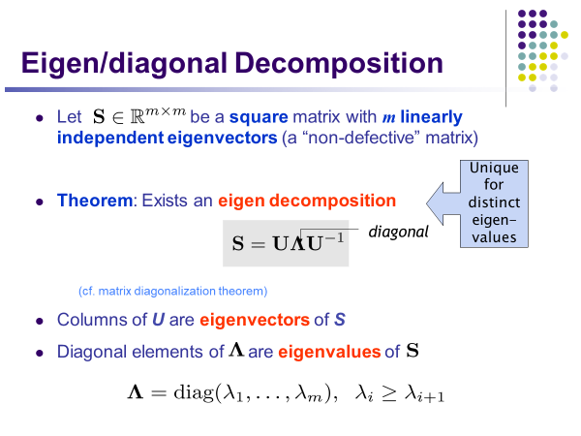

Slide 31
Eigenvalues & Eigenvectors
For symmetric matrices, eigenvectors for distinct eigenvalues are orthogonal
^{Sv}{1,2} ^{= λ}{1,2}^{v}{1,2} ^{, and λ}1 ^{≠ λ}2 ^{⇒ v}1 ^{• v}2 ⁼ ⁰
All eigenvalues of a real symmetric matrix are real.
if S − λI = 0 and S = S^{T} ⇒ λ ∈ℜ
All eigenvalues of a positive semidefinite matrix are non- negative
∀w∈ℜ^{n} , w^{T} Sw ≥ 0, then if Sv = λv ⇒ λ ≥ 0

Slide 32


How Many PCs?
For n original dimensions, sample covariance matrix is nxn, and has up to n eigenvectors. So n PCs.
Where does dimensionality reduction come from?
Can ignore the components of lesser significance.
25
20
15
10
5
0
PC1 PC2 PC3 PC4 PC5 PC6 PC7 PC8 PC9 PC10
You do lose some information, but if the eigenvalues are small, you don’t lose much
n dimensions in original data
calculate n eigenvectors and eigenvalues
choose only the first p eigenvectors, based on their eigenvalues
Variance (%)
final data set has only p dimensions
© Eric Xing @ CMU, 2006-2011
22

Slide 33
Singular Value Decomposition
For an m× n matrix A of rank r there exists a factorization (Singular Value Decomposition = SVD) as follows:
A = UΣV ^{T}
m×m
m×m
V is m×n
The columns of U are orthogonal eigenvectors of AA^{T}. The columns of V are orthogonal eigenvectors of A^{T}A. Eigenvalues λ₁ … λ_{r} of AA^{T} are the eigenvalues of A^{T}A.
σ _{i} = λ_{i}
Σ = diag(σ₁...σ _{r} )
Singular values.

Slide 34
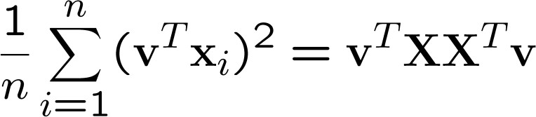
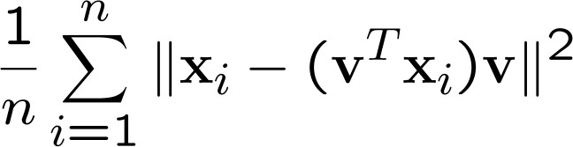
PCA: Two Interpretations
E.g., for the ﬁrst component.
Maximum Variance Direction: 1st PC a vector v such that projection on to this vector capture maximum variance in the data (out of all possible one dimensional projections)
Minimum Reconstruction Error: 1st PC a vector v such that projection on to this vector yields minimum MSE reconstruction

Slide 35



PCA: Two Interpretations
E.g., for the ﬁrst component.
Maximum Variance Direction: 1st PC a vector v such that projection on to this vector capture maximum variance in the data (out of all possible one dimensional projections)
Minimum Reconstruction Error: 1st PC a vector v such that projection on to this vector yields minimum MSE reconstruction
blue² + green² = black²
black² is ﬁxed (it’s just the data)
So, maximizing blue² is equivalent to minimizing green²
v

Slide 36
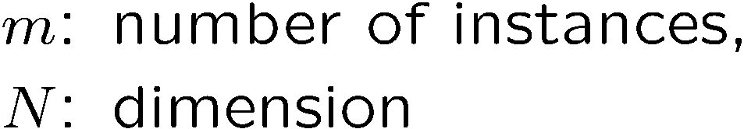
PCA algorithm III (SVD of the data matrix)
Singular Value Decomposition of the centered data matrix X.
^{X}features × samples ^{= USVT}
X
=
U S
_{V}T
sig.
 | noise
significant
noise
significant
noise
samples

Slide 37
PCA algorithm III
Columns of U
the principal vectors, { u⁽¹⁾, …, u^{(k)} }
orthogonal and has unit norm – so U^{T}U = I
Can reconstruct the data using linear combinations of { u⁽¹⁾, …, u^{(k)} }
Matrix S
Diagonal
Shows importance of each eigenvector
Columns of V^{T}
The coefficients for reconstructing the samples

Slide 38
SVD and PCA
The first root is called the prinicipal eigenvalue which has an associated orthonormal (u^{T}u = 1) eigenvector u
Subsequent roots are ordered such that λ₁> λ₂ >… > λ_{M} with rank(D) non-zero values.
Eigenvectors form an orthonormal basis i.e. u_{i} u_{j} = δ_{ij}
T
The eigenvalue decomposition of XX^{T} = UΣU^{T}
where U = [u₁, u₂, …, u_{M}] and Σ = diag[λ ₁, λ ₂, …, λ _{M}]
Similarly the eigenvalue decomposition of X^{T}X = VΣV^{T}
The SVD is closely related to the above X=U Σ^{1/2} V^{T}
The left eigenvectors U, right eigenvectors V,
singular values = square root of eigenvalues.

Slide 39
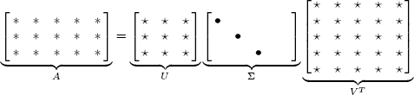
Low-rank Approximation
Solution via SVD
A = U diag(σ ,...,σ ,0,...,0)V ^{T}
k 1
k
set smallest r-k singular values to zero
k
k
A =
∑i=1
σ u v^{T}
column notation: sum of rank 1 matrices
k
i i i
© Eric Xing @ CMU, 2006-2011

Slide 40
Original sources include:
Karl Booksh Research group
Tom Mitchell
Ron Parr
PCA EXAMPLES
32

Slide 41
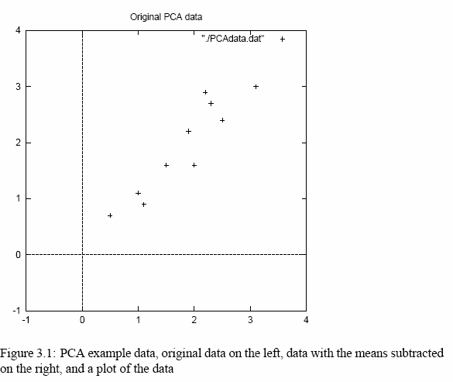


PCA Example –STEP 1
http://kybele.psych.cornell.edu/~edelman/Psych-465-Spring-2003/PCA-tutorial.pdf
DATA:
x
2.5 2.4
0.5 0.7
2.2 2.9
1.9 2.2
3.1 3.0
2.3 2.7
2 1.6
1 1.1
1.5 1.6
1.1 0.9
y
mean
this becomes the new origin of the data from now on

Slide 42
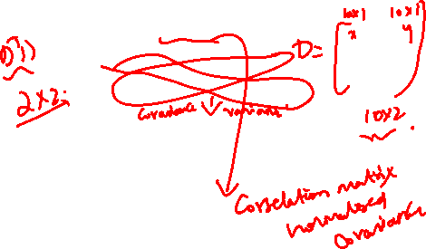
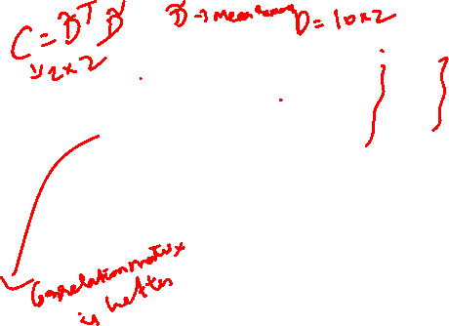
PCA Example –STEP 2
Calculate the covariance matrix
cov =
.616555556 .615444444
.615444444 .716555556
since the non-diagonal elements in this covariance matrix are positive, we should expect that both the x and y variable increase together.

Slide 43
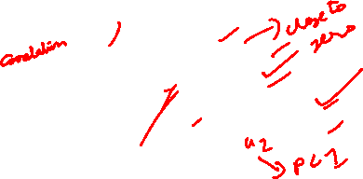
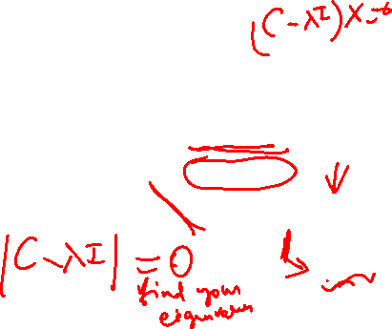
PCA Example –STEP 3
Calculate the eigenvectors and eigenvalues of the covariance matrix
eigenvalues = .0490833989
1.28402771
eigenvectors = -.735178656 -.677873399
.677873399 -735178656

Slide 44
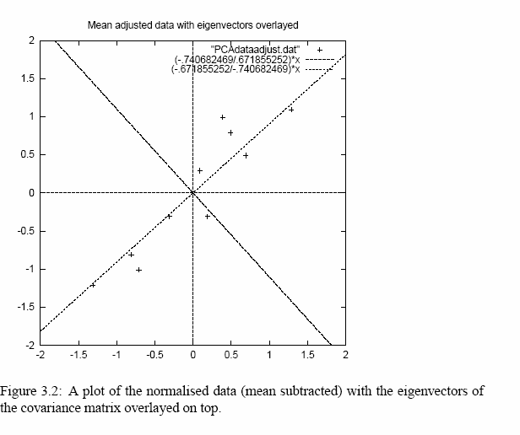
PCA Example –STEP 3
•eigenvectors are plotted as diagonal dotted lines on the plot.
•Note they are perpendicular to each other.
•Note one of the eigenvectors goes through the middle of the points, like drawing a line of best fit.
•The second eigenvector gives us the other, less
important, pattern in the data, that all the points follow the main line, but are off to the side of the main line by some amount.

Slide 45

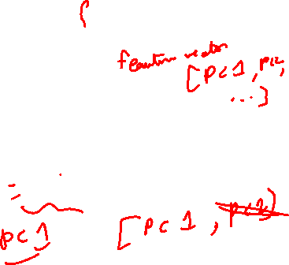
PCA Example –STEP 4
Feature Vector
FeatureVector = (eig₁ eig₂ eig₃ … eig_{n})
We can either form a feature vector with both of the eigenvectors:
-.677873399 -.735178656
-.735178656 .677873399
or, we can choose to leave out the smaller, less significant component and only have a single column:
- .677873399
- .735178656

Slide 46
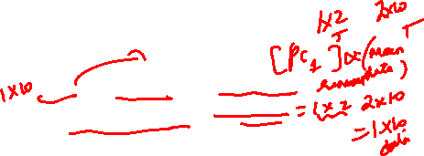
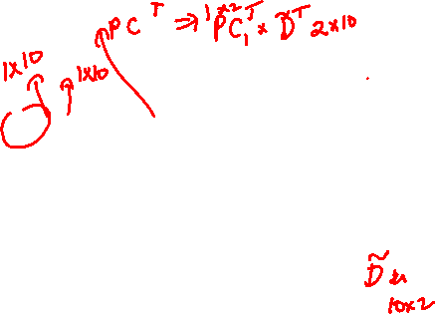
PCA Example –STEP 5
Deriving new data coordinates
FinalData = RowFeatureVector x RowZeroMeanData
RowFeatureVector is the matrix with the eigenvectors in the columns transposed so that the eigenvectors are now in the rows, with the most significant eigenvector at the top
RowZeroMeanData is the mean-adjusted data transposed, ie. the data items are in each column, with each row holding a separate dimension.
Note: this is essential Rotating the coordinate axes so higher-variance axes come first.

Slide 47
PCA Example : Approximation
If we reduced the dimensionality, obviously, when reconstructing the data we would lose those dimensions we chose to discard. In our example let us assume that we considered only the x dimension…

Slide 48
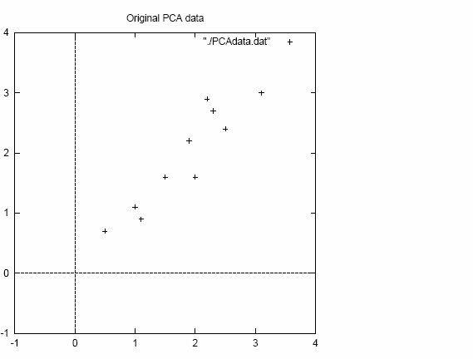
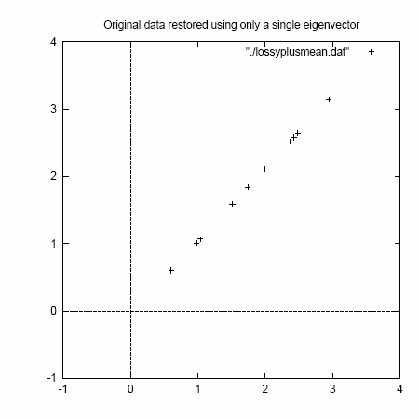
PCA Example : Final Approximation
2D point cloud
Approximation using one eigenvector basis

Slide 49
Face recognition

Slide 50
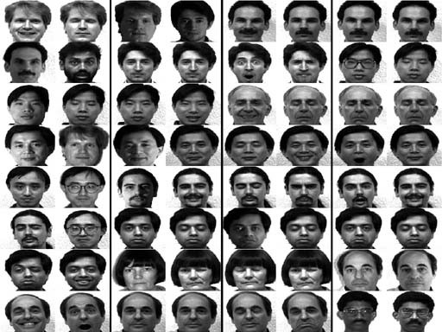
Challenge: Facial Recognition
Want to identify specific person, based on facial image
Robust to glasses, lighting,…
⇒ Can’t just use the given 256 x 256 pixels

Slide 51

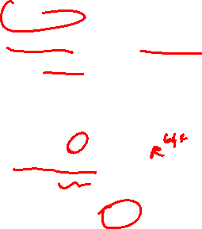
Applying PCA: Eigenfaces
Method A: Build a PCA subspace for each person and check which subspace can reconstruct the test image the best
Method B: Build one PCA database for the whole dataset and then classify based on the weights.
Example data set: Images of faces
– Famous Eigenface approach
[Turk & Pentland], [Sirovich & Kirby]
Each face x is …
256 × 256 values (luminance at location)
x₁, …, x_{m}
256 x 256
real values
_{– x in ℜ}256×256
(view as 64K dim vector)
X =
Form X = [ x₁ , …, x_{m} ] centered data mtx
Compute Σ = XX^{T}
Problem: Σ is 64K × 64K … HUGE!!!
m faces

Slide 52

Computational Complexity
Suppose m instances, each of size N
Eigenfaces: m=500 faces, each of size N=64K
Given N×N covariance matrix Σ, can compute
all N eigenvectors/eigenvalues in O(N³)
first k eigenvectors/eigenvalues in O(k N²)
But if N=64K, EXPENSIVE!

Slide 53

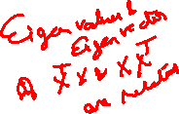

A Clever Workaround
Note that m<<64K
Use L=X^{T}X instead of Σ=XX^{T}
If v is eigenvector of L
then Xv is eigenvector of Σ
x₁, …, x_{m}
256 x 256
real values
X =
Proof:
L v = η v X^{T}X v = η v
X (X^{T}X v) = X(η v) = η
Xv
(XX^{T})X v = η (Xv)
Σ (Xv) = η (Xv)
m faces

Slide 54
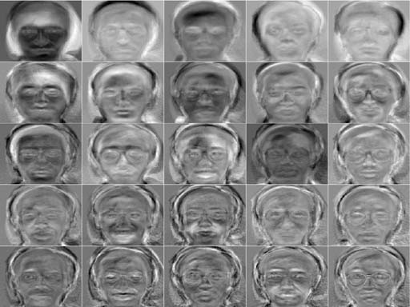
Principle Components (Method B)

Slide 55
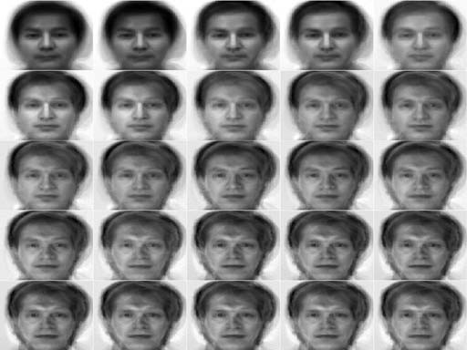
Reconstructing… (Method B)
… faster if train with…
only people w/out glasses
same lighting conditions

Slide 56
Shortcomings
Requires carefully controlled data:
All faces centered in frame
Same size
Some sensitivity to angle
Alternative:
“Learn” one set of PCA vectors for each angle
Use the one with lowest error
Method is completely knowledge free
(sometimes this is good!)
Doesn’t know that faces are wrapped around 3D objects (heads)
Makes no effort to preserve class distinctions

Slide 57
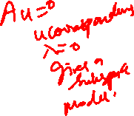

Slide 58


Slide 61

THANK YOU
Questions?

